Slide 1
Data Science: Zero to Hero
By Gary Short
Consulting Data Scientist
Darach.ai

Slide 2
Who Is This Fool?
(Almost) 30 years in the tech industry
Roughly split
15 years dev/architect
15 years as an applied data scientist
Ex Microsoft MVP C#
Ex Microsoft CSA(Advanced Analytics and AI)
Founder Darach.ai

Slide 3
None of that matters…

Slide 4
What really matters is…

Slide 5
I worked for my last client for 1030 days and I created an average of £28K per day in recurring savings or earnings… and I’m going to show you exactly how to do the same.

Slide 6
Agenda
Boring but necessary talking bit (1-1.5 hours)
Exciting practical bit. (2.5-3 hours)

Slide 7
Before we start…

Slide 8


Slide 9
I identify as…
Straight talking
Whisky drinking
Steak eating
Barbell lifting
Rugby supporting
Scotsman

Slide 10
And I can sometimes cause offence

Slide 11
But that’s okay, you’re allowed to be offended, learn to embrace that feeling

Slide 12
Rule1. Don’t be afraid to tell people their baby is ugly.

Slide 13
Example: the Universe does random stuff, so you haven’t discovered anything until you prove to me you’ve discovered something

Slide 14
Let’s look at the AI/ML lifecycle

Slide 15
Data Collection
EDA
Feature Selection
Model Selection
Train / Test Split
Model Evaluation
Hyper Parameter Tuning
Model Validation
Deployment
Monitor/Maintenance

Slide 16
Rule2: Two of them there are always.
There are only two types of data, quantitative and qualitative

Slide 17
Rule3. A place for everything and everything in its place

Slide 18
There are only 4 kinds of data
Structured
Semi-structured
Unstructured
Graph.

Slide 19
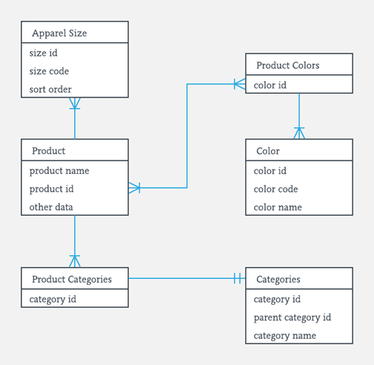
Structured

Slide 20
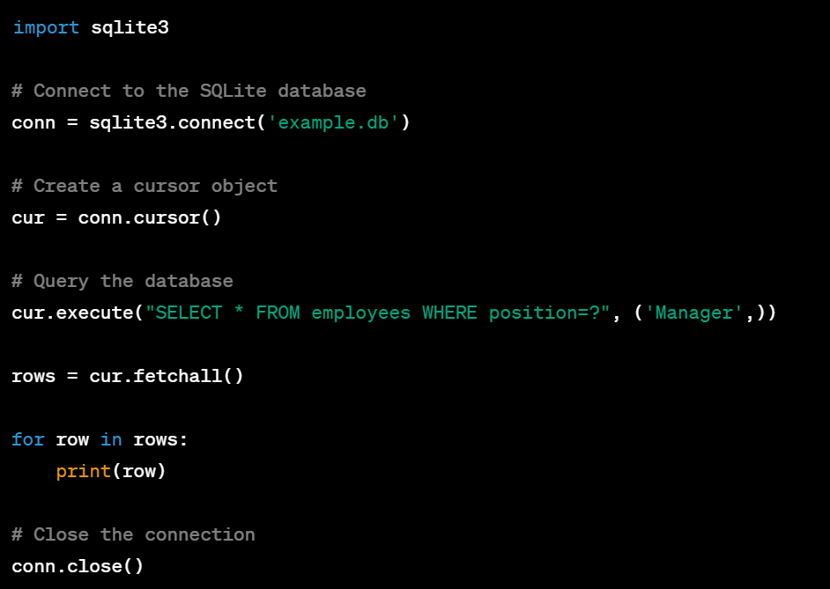
Querying Structured Data

Slide 21
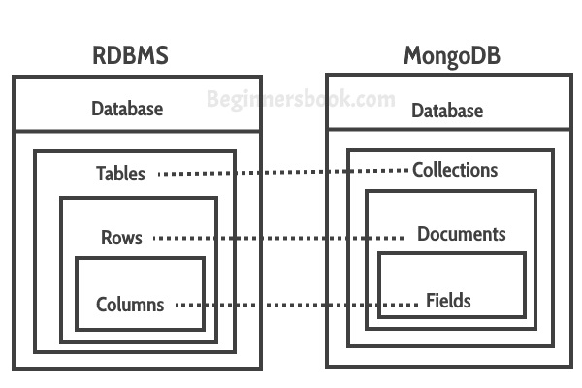
Semi-Structured Data

Slide 22
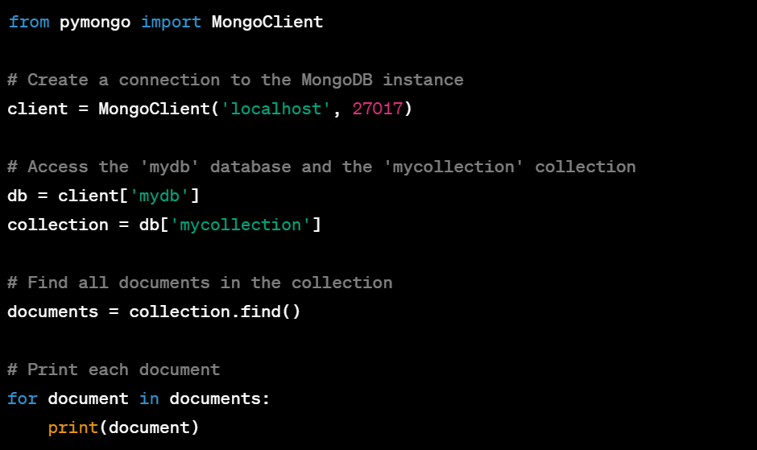
Querying Semi-Structured Data

Slide 23
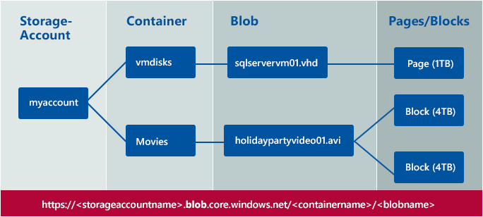
Unstructured Data

Slide 24
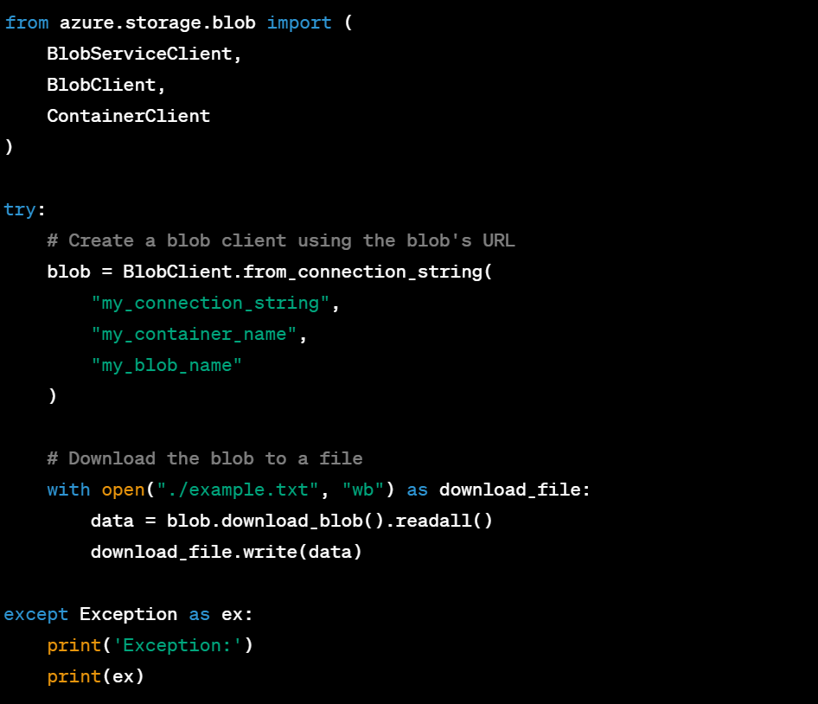
Querying Unstructured Data

Slide 25
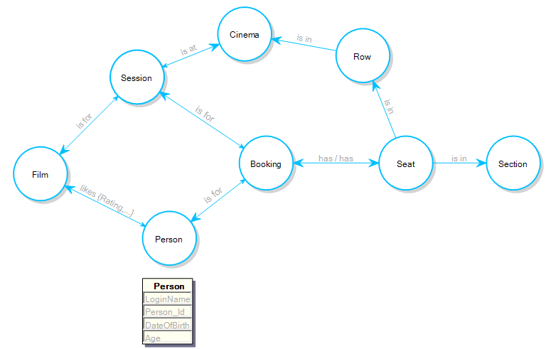
Graph Data

Slide 26
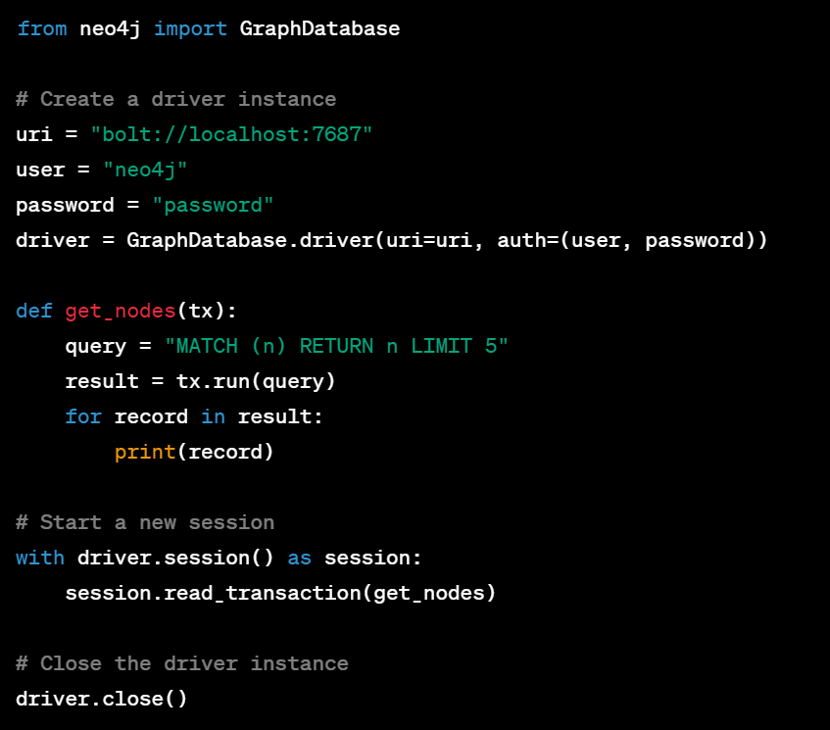
Querying Graph Databases

Slide 27
Rule3: You can only do maths with numbers

Slide 28
All AI/ML Works On One of These Data Types
Categorical
Ordinal
Numeric
Ratio.

Slide 29
Rule4: If you can’t explain it to a 6 year old, you don’t understand it.

Slide 30
Exploratory Data Analysis
Understand the variables
Handle missing values
Outlier detection
Univariate analysis
Bivariate analysis

Slide 31
Rule5: Many are called, but few are chosen.

Slide 32
Feature Selection
Preprocess the data: normalization/encoding categories
Bi/multivariate analysis: high correlation = redundant information
Feature Importance: check coefficients from regression and scores from Gradient Boosting

Slide 33
Rule6: Life is a competition, get used to it.

Slide 34
Model Selection
Use one or more models at a time, (I prefer a linear model and a non linear model), then pick the winner.

Slide 35
Rule7: You can’t mark your own homework.

Slide 36
Train/Test Split
Split your data 80/20
80% for training
20% for testing (the model never sees the test data during training)
Demo.

Slide 37
Rule8: The only easy day was yesterday

Slide 38
Model Evaluation
Outcome = model + error
Error = the difference between the predicted and observed value
Therefore the improve/evaluate loop is striving to reduce the error
Demo

Slide 39
Rule9: Every day, in every way, I’m getting better and better

Slide 40
Hyper Parameter Tuning
Every model has a set of parameters which govern how it works
There will be an optimal value for each of these parameters for your particular use case
Hyper parameter tuning is the act of finding these values
Use techniques like grid search
Demo.

Slide 41
Rule10: Round and round she goes, where she stops, no one knows!

Slide 42
Model Validation
To ensure your model doesn’t work by chance use…
K-Fold Cross Validation
Stratified Cross Validation
Demo.

Slide 43
Rule11: If it’s not in production, it doesn’t exist

Slide 44
Rule12: Be your own best competitor

Slide 45
Rule13: With great power comes great responsibility

Slide 46
I’m about to share with you something, if you choose to apply it, either professionally or personally, will fundamentally change your life.

Slide 47
The first is a formula, the second is a technique.

Slide 48
P(h|e) = P(e|h) * P(h) / P(e)

Slide 49
Estimation
The ability to estimate values for when you have no data, is extremely important
All those questions like “how many piano tuners are there in Chicago” that you all thought were dumb when Microsoft and Google asked them
Well this is what they were testing, and the ability to do it well, makes you a super hero in the applied AI space.
So, how do we do it?

Slide 50
How To Estimate
When trying to estimate the value a feature for which you have no data…
First, pick a value below which you know it couldn’t be, call this the minimum
Then pick a value above which you know it couldn’t be, call this the maximum
Next pick a value which you believe splits that range in two, such that there is an equal probability that the true value of X lies in either side. Try to avoid just selecting the mid point, this is almost always wrong. Call this value the median
Then repeat the last step, but instead of using the full range, use the minimum to the median. Call this value, Q1.
Now, repeat the step, but this time use the median to the maximum. Call this value Q3.
Lastly, use sampling to estimate the mean of the distribution you just described.

Slide 51
Demo

Slide 52
Now It’s Your Turn
Pick something you want to predict
Sports fan?
Politics?
Next tech hype?
Either
Use the “traditional” methods
Find some data online
Use the data science lifecycle to create a model
Or
Use your new super powers
Estimate distributions and calculate the mean of the data that you think will drive your prediction
And use the Bayesian formula to attach a probability to your hypothesis

